Slide 1
Tech M – Keysight 5G Projects
Global System Integrator Team
2020
Dan Sinawat

Slide 2
Tech Mahindra POC Project Plan
Phase 1 – Private Cloud Openstack with KVM
Private Cloud – OpenStack with KVM
NFVI Validation – CloudPeak
5G Core Emulation – LoadCore;
4G Core Emulation – Ixload VE
Automation – Test Module Integration
External integration via REST API with Net.Ops
Phase 2 – Public Cloud AWS
Public Cloud – AWS
NFVI Validation – CloudPeak
5G Core Emulation – LoadCore;
4G Core Emulation – Ixload VE
Automation – Test Module Integration
External integration via REST API with Net.Ops

Slide 3
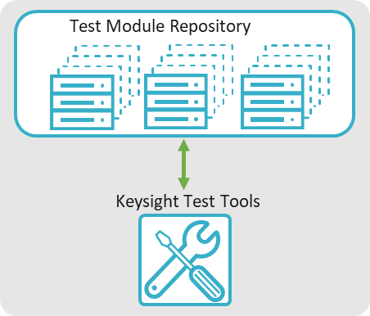

Automation Architecture
NetOps.ai
Close to User Access
GUI
REST API
REST API
NFVi Testing
4G and 5G Testing
Typically all in
one location
Keep tools and SUT in same environment
Interconnects
SUT
Interconnects
NVFI
Switches
Interconnects
Network VNF
Compute VNF
Other VNF

Slide 4
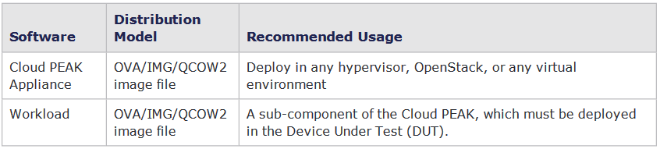
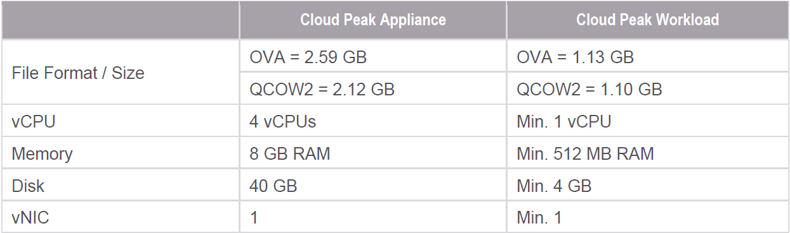
Cloud Peak Deployment
Virtual Machines :
Cloud PEAK Appliance;
Workload Images
Medium Deployment Licensing:
4 parallel executions ;
Limits per Test – up to 512 vCPU and 2040GB RAM

Slide 5
Cloud Peak + Test Module Deployment Stages
Prepare VM Images
Download CloudPeak VM Images from our Support Portal
https://support.ixiacom.com/software-downloads/234082
Deploy VM on the Public/ Private Cloud infrastructure using our Install Guide
Access Management console via Web Ui
Product Licensing
Integrate Cloud Peak with NFVI Infrastructure
Execute Benchmark Tests
Add Test Modules for 4G /5G Testing and integrate Test Module with Ixload VE and 5G LoadCore
REST API Automation integration with external Net.Ops Orchestrator
Automate Tasks to automatically execute test cases

Slide 6
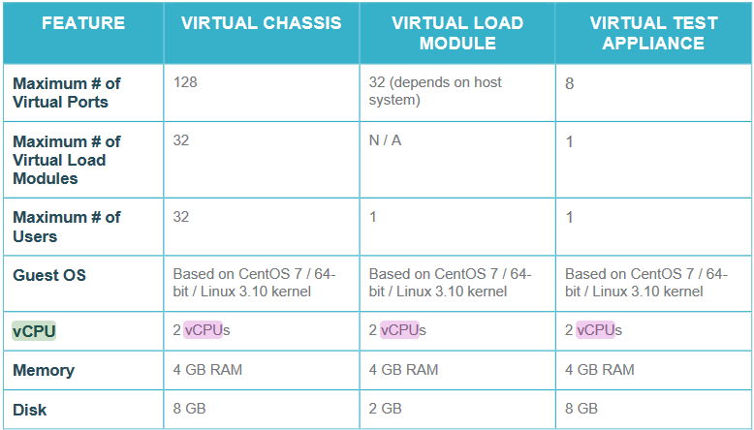
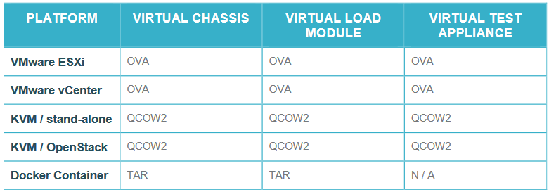
Ixload VE Deployment
IxLoad Client – Windows OS – for GUI Manual Config
Ixload VE Virtual Machines
Ixload Virtual Chassis
Ixload Load Module
Ixload VE Tier4 license need to emulate 4G LTE Core Nodes
Network interfaces – 1G /10G
Licensing - Ixload Tier 4 10G Licenses
Optional licensing for Diameter

Slide 7
Ixload VE Deployment Stages Overview
Prepare VM Images
Download IxLoad Images from our Support Portal https://support.ixiacom.com/ixvm-ixos-910-ixnetwork-910-ixload-910
Deploy VM on the Public/ Private Cloud infrastructure using our Install Guide
Product Licensing
Access Virtual Chassis via Web Ui and attach one or more Virtual Load Modules and port
Connect from Ixload Windows Client GUI to the Virtual Chassis on File-> Ports -> Add Chassis and manual test Ixload functionalities
Deploy Test Modules in CloudPeak /IxSuiteStore with predefined 4G EPC test cases ;
Run Test cases from the Test Module Library
REST API automation integration with external Net.Ops Orchestrator
Automate Task from Net.Ops to execute Test Cases

Slide 8
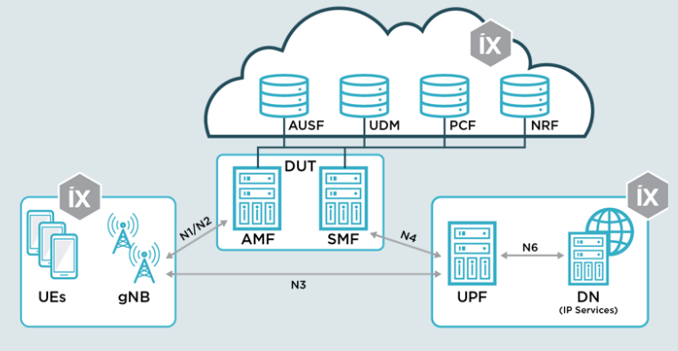
5G Load Core
5G LoadCore Virtual Machines :
Middleware VM
4 x vCPU
8GB RAM
30 GB HDD
Agent VM
4 x vCPU;
8GB RAM;
30 GB HDD
License Sever VM
2vCPU;
4GB RAM
10GB HDD
Licensing – 11 interfaces needed to emulate the whole 5G Core Nodes ;
Additional Licensing Needed for 1M UEs Control Plane
Additional Licensing Need for 1M UEs User Plane traffic

Slide 9
MGMT
WindowsClient/License Server
VLOAD Gn
VLOAD GI
Gn
Gi
VChassis
EPC_CORE

Slide 10
5G LoadCore Deployment Stages Overview
Prepare VM Images
Download 5G Loadcore Images from our Support Portal https://support.ixiacom.com/software-downloads/236052
Deploy 5G Loadcore Middleware VM and one or Agent VMs on the Public/ Private Cloud infrastructure using our Installation Guide
Provision Loadcore Network Management and Test NIC interfaces
Login to Loadcore Agents and runs agent-setup.sh script and connect to the Middleware VMs
Product Licensing from the Web UI of the Licensing Server
Access Middleware Web UI for Lodcoremanual configurations
Deploy Test Modules in CloudPeak /IxSuiteStore with predefined 5G Core test cases
Run 5G Test cases from the Test Module Library
REST API automation integration with external Net.Ops Orchestrator
Automate Task from Net.Ops to execute Test Cases

Slide 11
Timeline proposal draft
High Level Design – 2-3 days
Validate Testing Architecture – 1-2 days
Prepare and Provision Deployment environment – 1-2 days
Ixload VE Basic Setup Deployment – 1 week
Loadcore Basic Setup Deployment – 1 week
Cloud Peak + Test Module Setup Deployment – 1 week ;
REST API integration with Net.Ops Orchestrator – 2-3 Days
Test and Validate Automation – from 1 to 3 weeks

